Slide 1
House Price Prediction COMP9322 Assignment Presentation Group: Hahah Members: Fanmo Li, Jinlong Zhang, Junhua Lyu, Keshi Chen, Yi Lu
May 2018

Slide 2
Overview
Overview of the Project
Introduction of Models
Demo

Slide 3
Overview of the Project
The goal of the project.
Main Functionalities

Slide 4
The goal of the project
The prediction of house prices using external data and some pre-existing software.

Slide 5
Main Functionalities
Download data containing property prices.
The application to make house price prediction.
Understandable presentation by customers.
Export the result as PDF or graph.
User login/logout, user profile updating.

Slide 6
Introduction of Models
The architecture of the model
Information model
Services model
Graphical user interface model
End-to-end process model

Slide 7
The architecture of the model
Information model: Defines and provides concepts (e.g. data types, data source and programs, etc.) for other models.
Services model: Models micro-services used by the application.
Graphical user interface model: Models the user interface to provide understandable interactions for customers.
End-to-end process model: Models the inner-logic of the application (e.g. how pages jump from one to another, the call of services, etc.)

Slide 8
Information model
Dataset
DatasetType
DataSource
Results
DataProcessingProgram
NameGeneratingProgram
DataExportingProgram
ResultForm
User

Slide 9
Services model
Create Dataset
Data Processing
Download Dataset
Import Dataset
Predict by Neural Network
Predict by Regression
User Login
User Logout
User Register
User Update
VisualizeDataset

Slide 10
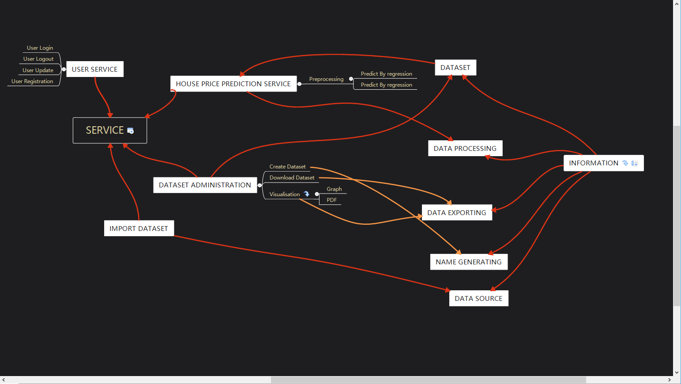
Inner-relationship between Information and services
Information model: Defines and provides concepts (e.g. data types, data source and programs, etc.) for other models.
Services model: Models micro-services used by the application.
Graphical user interface model: Models the user interface to provide understandable interactions for customers.
End-to-end process model: Models the inner-logic of the application (e.g. how pages jump from one to another, the call of services, etc.)

Slide 11
Graphical user interface model
Create Dataset Interface
Execute Model Interface
Download Dataset Interface
Import Dataset Interface
Exporting Method Selection Interface
Main Page
Result Page
User Logout Interface
User Register Interface
User Update Interface
Visualize Dataset Interface

Slide 12
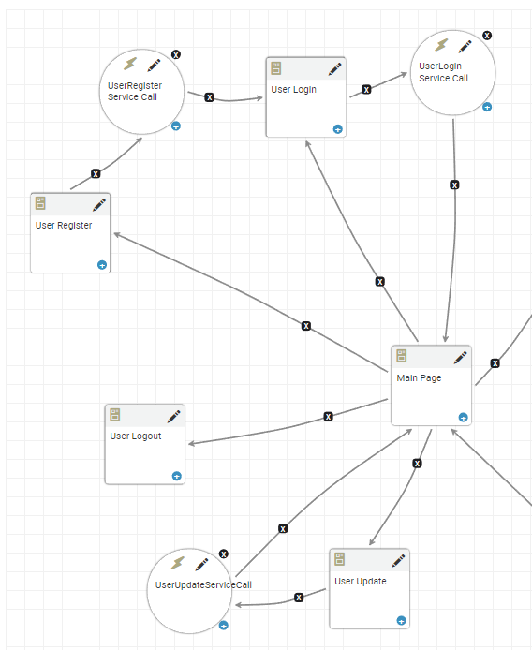
Integrate user interfaces with end-to-end process

Slide 13
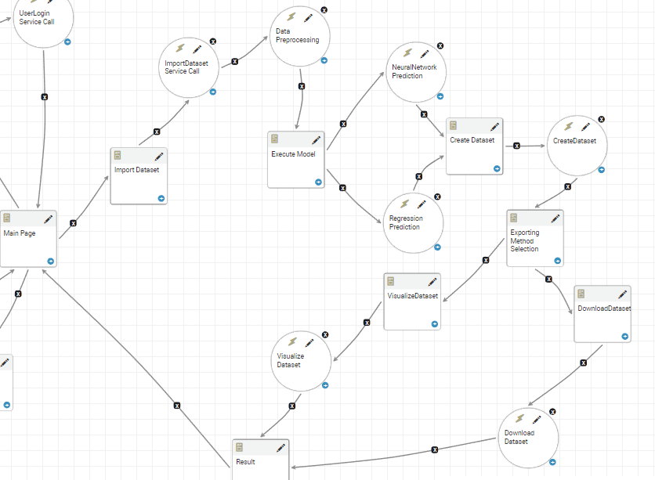
Integrate user interfaces with end-to-end process

Slide 14
End-to-end process model
See Demo

Slide 15
DEMO

Slide 16
Thank you!

